Slide 1
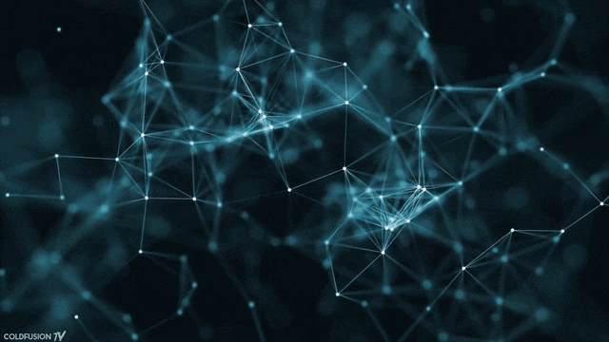
Generative Adversarial Networks
Shobhit
Software Engineer, Qualcomm
IIT Bhubaneswar, India

Slide 2
Agenda
Generative modelling
Coolest applications
GANs components and its architecture
GANs training
Difficulties during training
Use case

Slide 3
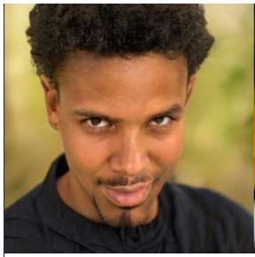
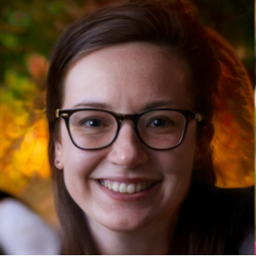
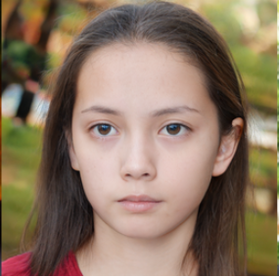
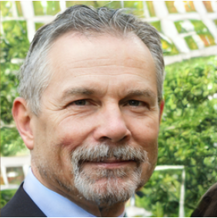

Let’s Play Game - Identify Real or Fake One
Generated From StyleGAN2
These People Don’t Exist

Slide 4
Generative Modelling – Density Estimation
… ..
.. …. …. …… ……….
… ..
.. …. …. …… ……….

Slide 5
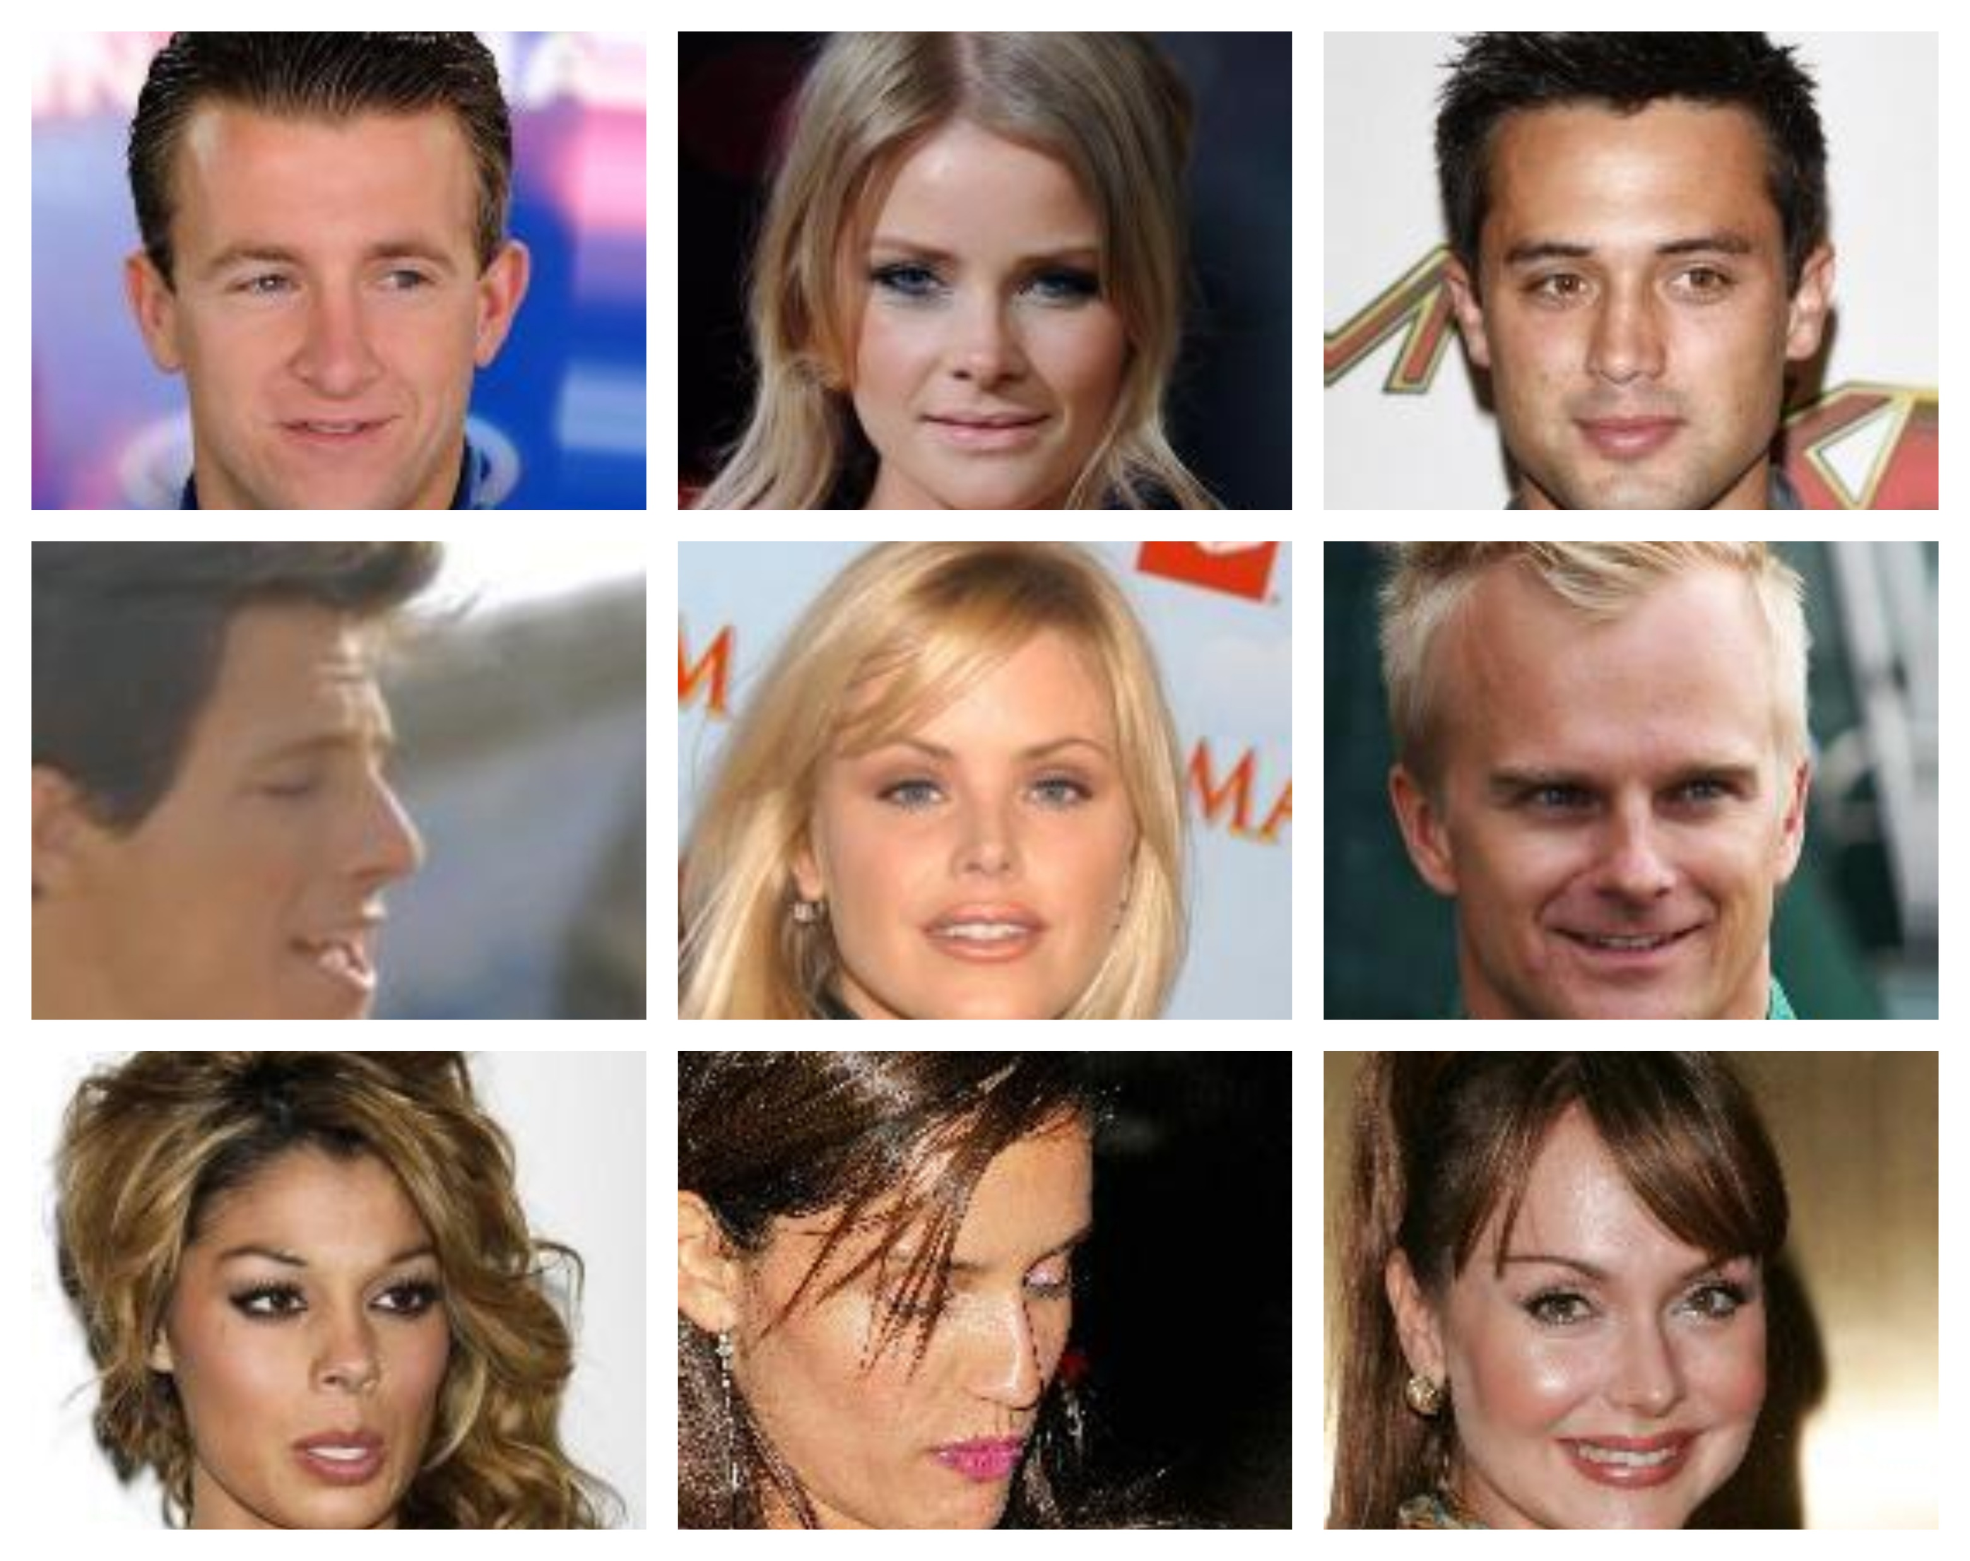
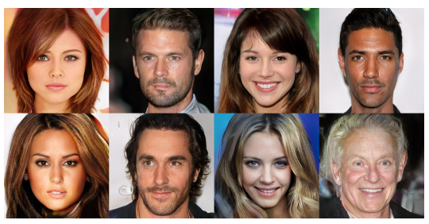
Generative Modelling – Sample Generation
Celeb A dataset
Generated Images
Tero Karras et.al. (2018). Progressive Growing of GANs for Improved Quality, Stability, and Variation.

Slide 6
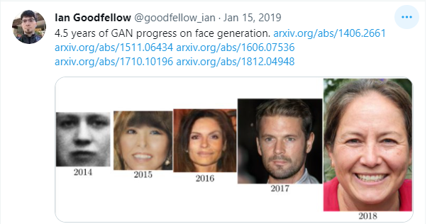
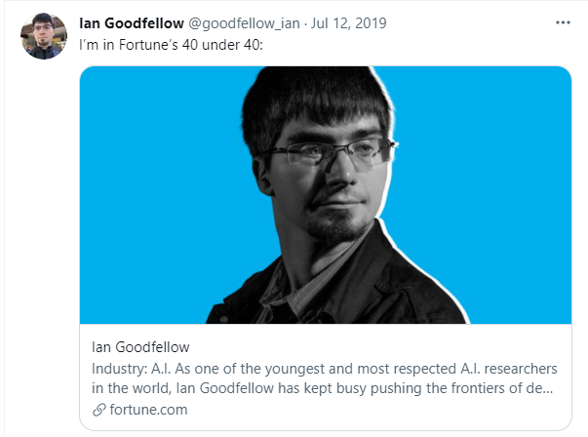
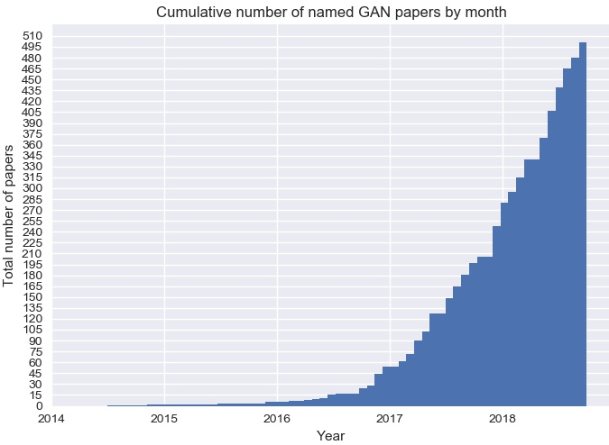
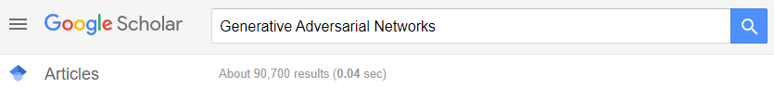
Inventor of GANs – Ian Goodfellow
Around 33,300 citation is on original paper of GANs
https://github.com/hindupuravinash/the-gan-zoo

Slide 7
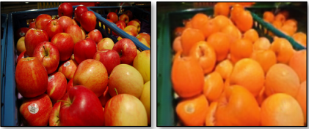
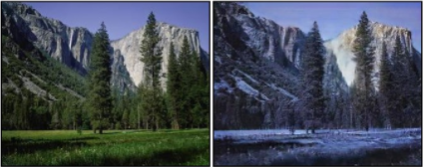
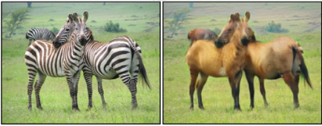
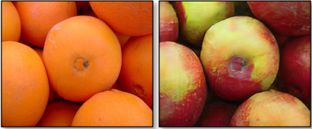
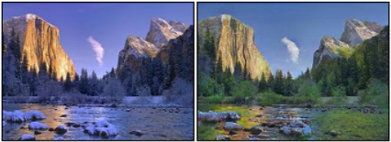
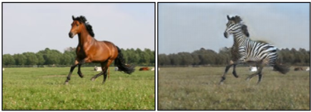
Coolest Application – CycleGAN
Apple
Orange
Summer
Winter
Zebra
Horse
Apple
Orange
Summer
Winter
Zebra
Horse
Orange
Apple
Winter
Summer
Horse
Zebra
Zhu, Jun-Yan, et al(2020). ‘Unpaired Image-to-Image Translation Using Cycle-Consistent Adversarial Networks’.

Slide 8
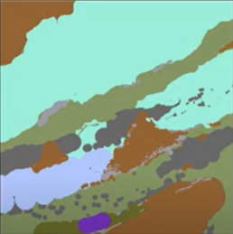
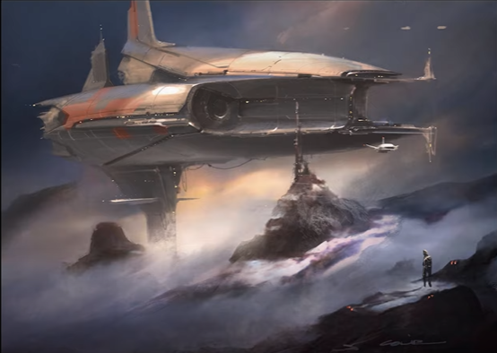

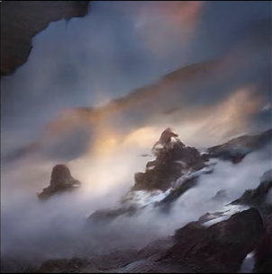
Coolest Application – Nvidia GauGAN
Segmented Input
http://nvidia-research-mingyuliu.com/gaugan/
GauGAN Output
Colie Wertz Paint Over
Colie Wertz, Senior Concept Artist Rogue one: A Starwars story, Bumblebee,
Captain America: Civil Wars

Slide 9
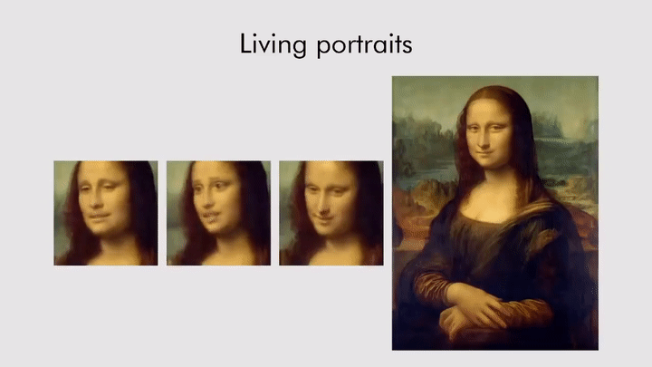
Coolest Application
Zakharov, Egor, et al.(2019) “Few-shot adversarial learning of realistic neural talking head models”

Slide 10
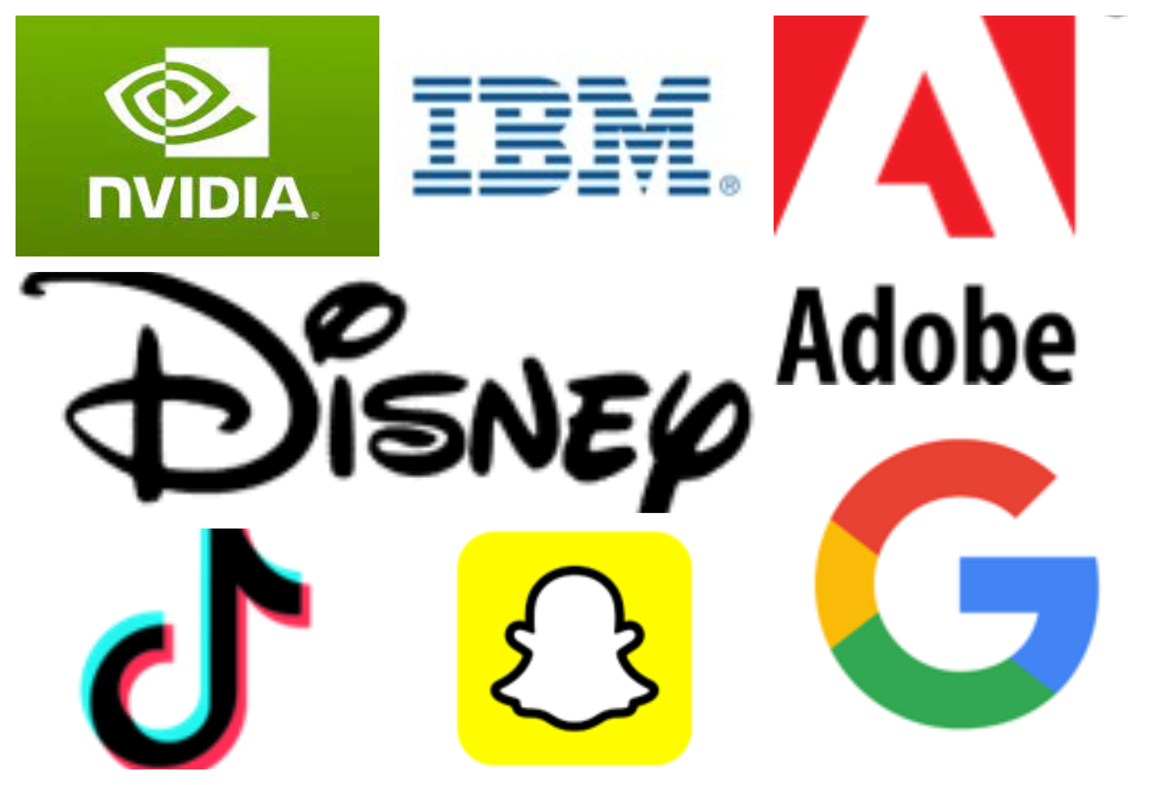
Companies Using GANs

Slide 11
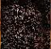
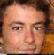
Why GANs
Simulate all possible future plans
Missing Values
Realistic generation tasks
Multiple correct answers
Data augmentations
Example
Generative model
reveals a face
(Yeh et al., 2016)

Slide 12
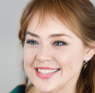

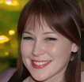
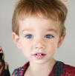
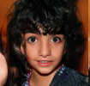
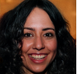


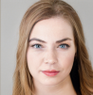

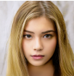
GANs Components
Generator
Discriminator
It will generate Fakes data that looks like Real
It is like a Art Forger
It will learn to distinguish Real from Fake
It is like a Art Inspector
Real
Fake

Slide 13
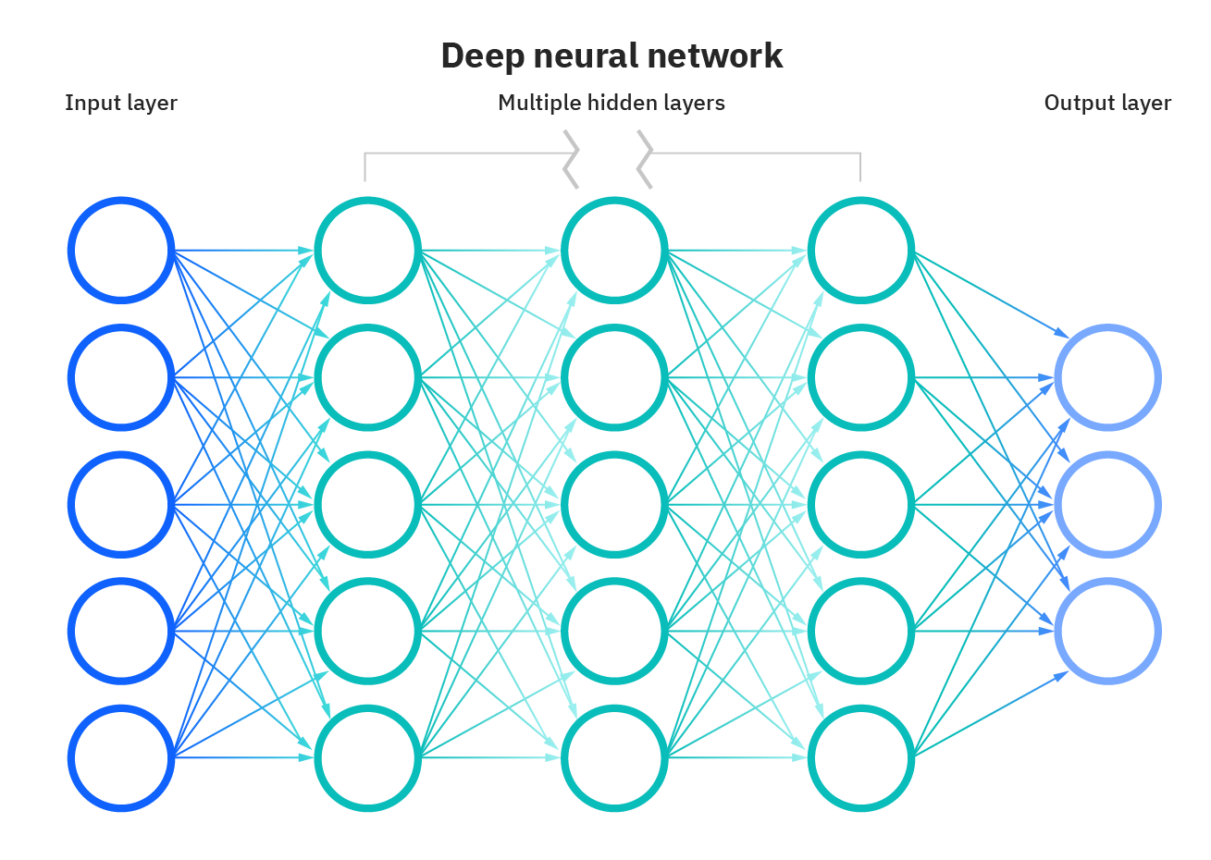
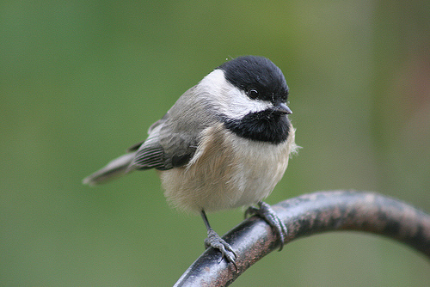
Discriminator - Classifiers
Tiger
Bird
Cat
Ref: ImageNet
Ref: IBM

Slide 14
Discriminator - Training
Ɵ
Trainable Parameters
Back Propagation
d
Feature
X
Output
Ŷ
Loss Function
J(Ɵ) = f(Y, Ŷ)
Discriminator
Real Label
Y

Slide 15
Back Propagation Example

Slide 16
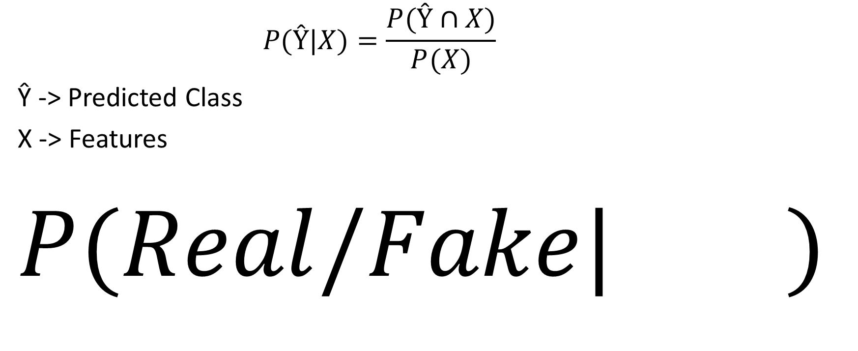
Discriminator - Probability
$$P(Ŷ|X)=\frac{P(Ŷ∩X)}{P(X)}$$
Ŷ -> Predicted Class
X -> Features
$$P(Real/Fake| )$$

Slide 17
Generator
Feature X
Generator
Noise Vector

Slide 18
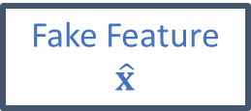
Generator - Training
Ɵ
Trainable Parameters
Back Propagation
g
Fake Feature
$$\hat{x}$$
Output
Ŷ
Loss Function
J(Ɵ) = f(1, Ŷ)
Discriminator
Generator
Noise
Vector

Slide 19
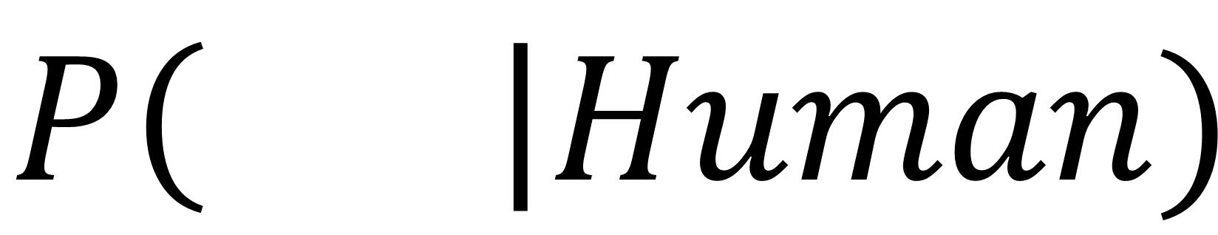
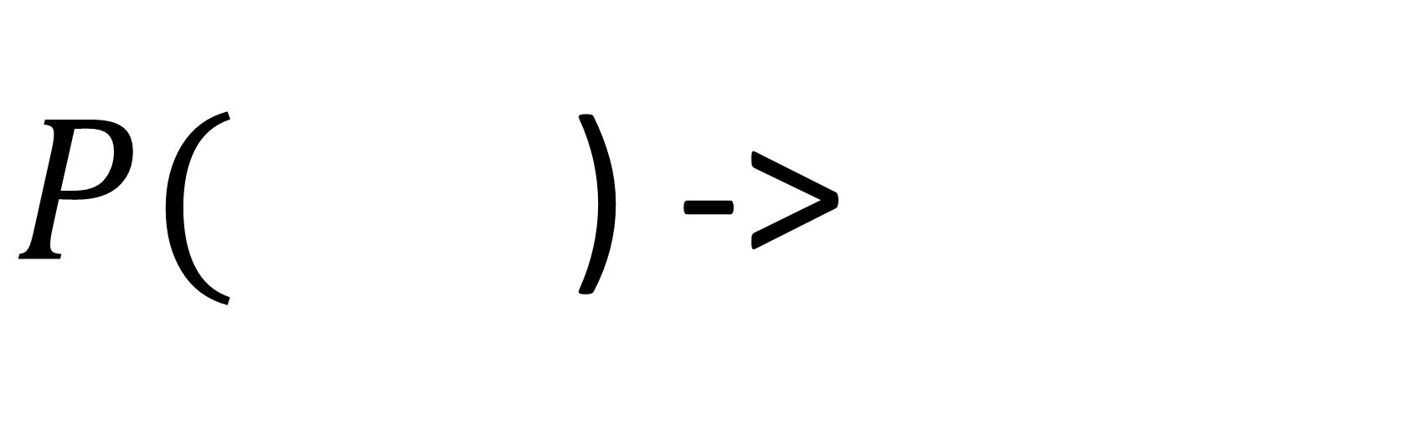
Generator - Probability
$$P\left( \right|Human)$$
$P($ ) ->
Generate possible faces

Slide 20
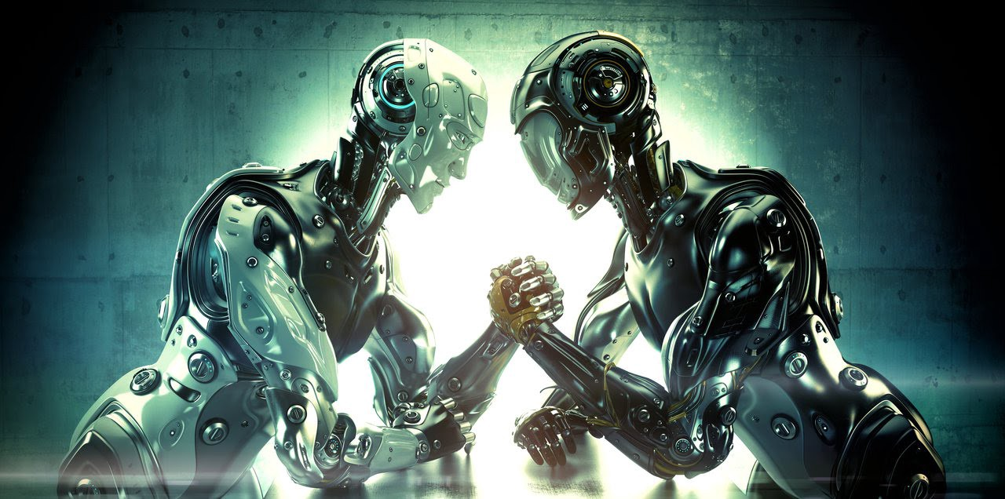
Generator
Discriminator
https://www.deviantart.com/ociacia/art/Robotic-Arm-Wrestling-437570457

Slide 21
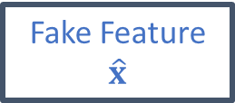
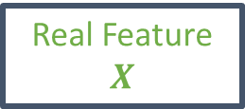
GAN - Model
Real Feature
$$X$$
Output
Ŷ
Discriminator
Fake Feature
$$\hat{x}$$
Generator
Noise Vector

Slide 22
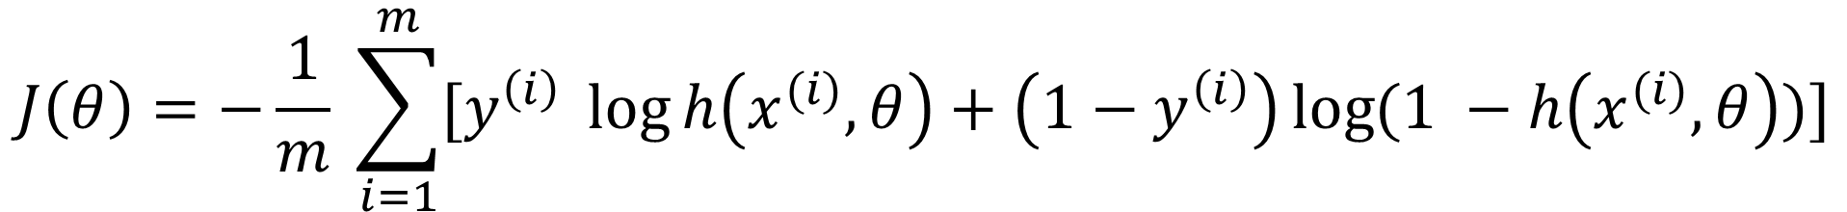
Loss Function Example – Binary Cross Entropy
$$J\left(θ\right)=−\frac{1}{m} \sum_{i=1}^{m}{[y^{\left(i\right)} \log{h\left(x^{(i)}, θ\right)+\left(1−y^{\left(i\right)}\right)\log{(1 −h\left(x^{(i)}, θ\right))}}]}$$
Prediction
Labels
Features
Average Loss over whole batch
Parameters

Slide 23
Difficulties - Training
Non Convergence
Mode Collapse
Metz, Luke, et al.(2016) "Unrolled Generative Adversarial Networks."

Slide 24
Major Types of GANS
Conditional GAN
InfoGAN
DCGAN
StackGAN
Wasserstein GANs(WGAN)

Slide 25
My Contributions to the Projects of GANs Domain

Slide 26
Use Case1 – Malware Detection
Domain : Novel Malware Generation and Detection
Idea : Detect those malware which haven’t seen yet. To secure our systems from future attacks.
Paper : Shobhit and P. Bera, "ModCGAN: A Multimodal Approach to Detect New Malware”, 2021 International IEEE Cyber Science Conference, Ireland
YouTube Link : https://www.youtube.com/watch?v=6-iwKgrKyPY

Slide 27
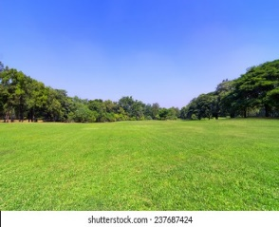
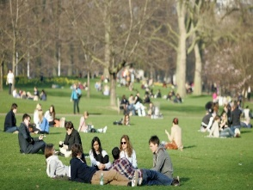
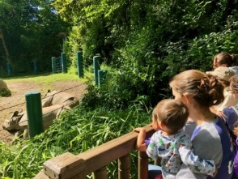
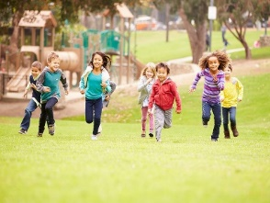
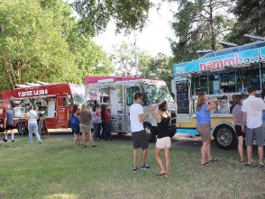
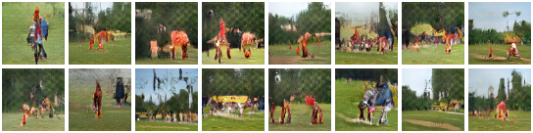
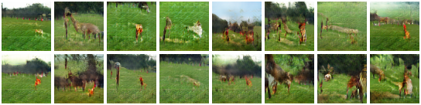
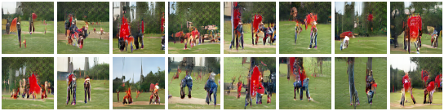
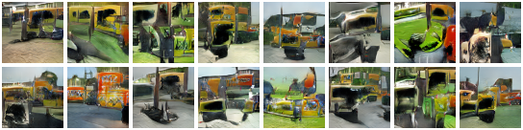

Use Case 2 : Image Sequence Generation from Text
Ground Truth
Generated Images
Story
The park was empty.
Many people entered the park.
After sometime, animals entered.
There were many children who were playing.
There was a food truck near it.
@Rohit Agarwal
Confidential

Slide 28
Links – Applications of GANs Enjoy!
http://nvidia-research-mingyuliu.com/vid2vid-cameo/
http://nvidia-research-mingyuliu.com/ganimal
http://nvidia-research-mingyuliu.com/gaugan
https://www.nvidia.com/research/inpainting/index.html
https://www.wombo.ai/

Slide 29
Summary
GANs are generative models that are implemented using two stochastic neural network modules: Generator and Discriminator.
Generator tries to generate samples from random noise as input
Discriminator tries to distinguish the samples from Generator and samples from the real data distribution.
Both networks are trained as adversaries to fool the other component. In this process, both models become better at their respective tasks.
Can be trained using back-propagation for Neural Network based Generator / Discriminator functions.
Sharper images can be generated.
Faster to sample from the model distribution: single forward pass generates a single sample.

Slide 30
Questions & Thank You

Slide 31


Code Polymorphism
ModCGan
Enabled
System
Code Mutation
Code Obfuscation
Self Modification

